Slide 1




UAV-Assisted Task Offloading in Vehicular Edge Computing Networks
浙江工业大学演示模板
POWERPOINT TEMPLATE
汇报人
韩旭涛
(Ieee Transactions on Mobile Computing | 2024)

Slide 2

01
Introduction
02
Methodology
CONTENTS
03
Experiment
04
Conclusion

Slide 3

`
Introduction
01

Slide 4

Background
Vehicular edge computing (VEC) provides an effective task offloading paradigm by pushing cloud resources to the vehicular network edges, e.g., road side units (RSUs).

Slide 5
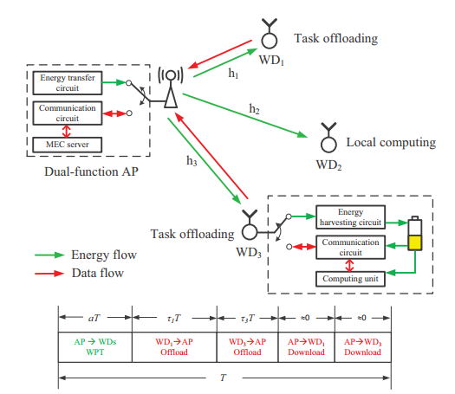
Background
the time-varying wireless channel condition
an example of wireless powered MEC system
impact
the optimal offloading decision of a wireless powered MEC system
key to solving the problem
joint optimization of individual computing mode (offloading or local computing) and wireless resource allocation(the transmission air time divided between WPT and offloading)
formulated
mixed integer programming (MIP) problems

Slide 6
Contributions
proposed a Deep Reinforcement learning-based Online Offloading (DROO) framework that learns from the past offloading experiences under various wireless fading conditions, and automatically improves its action generating policy.
DROO decomposes the original optimization problem into an offloading decision subproblem and a resource allocation subproblem.It works for continuous state spaces and does not require the discretization of channel gains, thus, avoiding the curse of dimensionality problem.
To efficiently generate offloading actions, we devise a novel order-preserving action generation method.
We further develop an adaptive procedure that automatically adjusts the parameters of the DROO algorithm on the fly.

Slide 7
`
Methodology
02

Slide 8
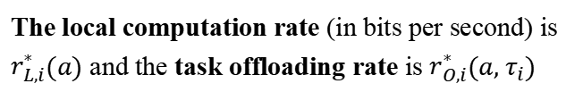
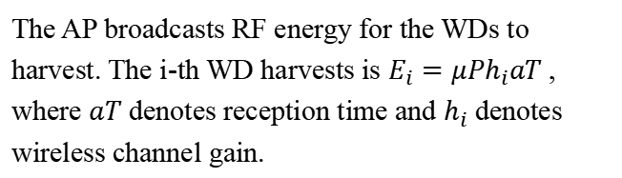
System Model
Just consider an AP and N WDs. The system time is divided into consecutive time frames of equal lengths T, which is set smaller than the channel coherence time.
The AP broadcasts RF energy for the WDs to harvest. The i-th WD harvests is $E_{i}=μPh_{i}aT$, where $aT$ denotes reception time and $h_{i}$ denotes wireless channel gain.
The local computation rate (in bits per second) is $r_{L,i}^{∗}(a)$ and the task offloading rate is $r_{O,i}^{∗}(a, τ_{i})$
The final optimization objective is
Notes:
现有 MARL 方法与我们提出的方法之间的比较。
大都市中的多代理场景示例，每个区块对应一个代理，相邻区块之间的关系导致代理与代理之间的互动。
CTDE 方法的局限性，即批判者输入向量的维度过高。（考虑每个智能体与其他智能体间的交互）
未加权 MF 的局限性，即使用未加权平均值对代理-代理互动建模时会失去精确性。
我们提出的 GAT-MF 方法的关键设计，在保持精度的同时降低维度。（仅需考虑各智能体与平均场的交互）

Slide 9


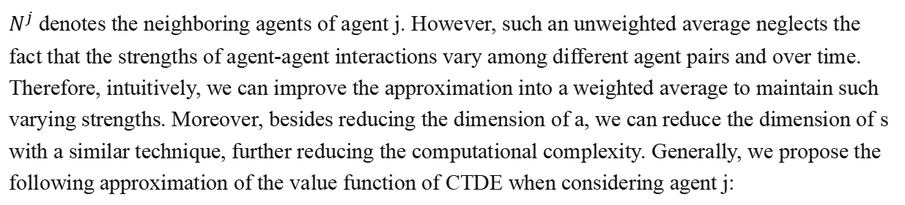
Methodology
As shown in Figures b and c, for agent j , the value function of the unweighted MF to the CTDE uses the following approximation:
$N^{j}$ denotes the neighboring agents of agent j. However, such an unweighted average neglects the fact that the strengths of agent-agent interactions vary among different agent pairs and over time. Therefore, intuitively, we can improve the approximation into a weighted average to maintain such varying strengths. Moreover, besides reducing the dimension of a, we can reduce the dimension of s with a similar technique, further reducing the computational complexity. Generally, we propose the following approximation of the value function of CTDE when considering agent j:
Notes:
如图b和c，这种没有加权的方法忽略了智能体之间交互的多样性，使用了价值函数的近似值来进行计算。
但是将智能体之间的互动强度的不同考虑在内时，就需要对各边进行加权，使用价值函数的近似值采用加权平均进行计算。对于动作a和状态s采取同样的方案。

Slide 10

Methodology
On the other hand, they design a similar weighted average approximation to reduce the computational complexity of policy function, i.e., the actor, as follow:
Notes:
另外，论文还设计了类似的加权平均近似法可以降低政策函数（即行动者）的计算复杂度，具体如下。

Slide 11
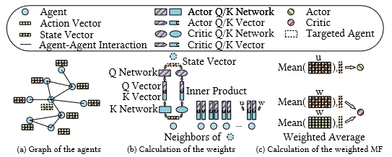
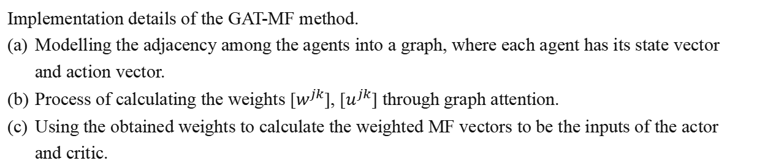
Methodology
Implementation details of the GAT-MF method.
Modelling the adjacency among the agents into a graph, where each agent has its state vector and action vector.
Process of calculating the weights [$w^{jk}$], [$u^{jk}$] through graph attention.
Using the obtained weights to calculate the weighted MF vectors to be the inputs of the actor and critic.
Notes:
GAT-MF 方法的实施细节。
将代理之间的相邻关系建模为一个图，每个代理都有自己的状态向量和行动向量。
通过图注意计算权重 [w jk ]、[u jk ] 的过程。
利用获得的权重计算加权平均场向量，作为行动者和评论者的输入。
将代理之间的邻接关系建模为一个图 G（图 2a），其中每个节点对应一个代理。为了获得权重 [w jk] 和 [u jk]，作者设计了一种图关注（GAT）机制的变体来自动学习它们，它们反映了每个代理与其邻居之间不同的交互强度。

Slide 12
`
Experiment
03

Slide 13
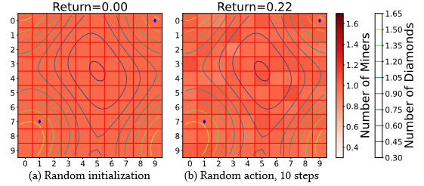
Experiment
The authors start with a diamonds-seeking task in a manual grid world consisting of 10×10 grids with loop boundaries, i.e., going out from the left will loop into the right, and each grid corresponds to one agent. Paper shows a randomly initialized example of the grid world in Figure a.
In each time step, 10% of the miners from each grid move to one of its neighbors, and the task of the agents is to give the exact numbers of miners to each of the four neighbors to efficiently redistribute the miners and get as many diamonds as possible. Paper shows the distribution of miners and the return after 10 steps of random movements in Figure b as an example.
Notes:
作者在一个由 10×10 个网格组成的人工网格世界中开始一项寻找钻石的任务，该网格具有循环边界，即从左边出去会循环到右边，每个网格对应一个代理。在图 3a 中展示了一个随机初始化的网格世界示例。最初，有两个钻石矿脉埋藏在两个随机网格中（图中的蓝色标记），整个世界的钻石密度（用等高线表示）遵循以两个网格为中心的高斯分布。网格上还均匀分布着矿工，其数量用背景颜色表示。
在每个时间步中，每个网格中 10% 的矿工会移动到它的一个邻居那里，而代理的任务就是向四个邻居中的每一个提供准确数量的矿工，以便有效地重新分配矿工，尽可能多地获得钻石。我们以图 3b 为例，展示了随机移动 10 步后的矿工分布和回报。

Slide 14
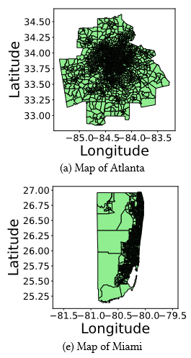
Experiment
The authors conduct their experiments based on the simulator in two different cities, Atlanta and Miami, ensuring the ability of generalization of their method. In each city, there are thousands of blocks, corresponding to thousands of agents (Figure a and e). People in each block have different age structures and time-varying patterns visiting points of interest (POI1s) in the city. The population mobility leads to contacts among people and complex and time-varying risks of infection.
The task of the agents is to find an efficient way to allocate the limited vaccines among the blocks at each time step, reduce the local risk of infection in certain key blocks, and thus minimize the overall infections, which is opposite to the return.
Notes:
作者基于模拟器在亚特兰大和迈阿密两个不同的城市进行了实验，以确保他们的方法具有通用性。每个城市都有数千个街区，对应数千个代理人（图 4a 和 4e）。每个街区的居民都有不同的年龄结构和访问城市中兴趣点（POI1）的时变模式。人口流动导致了人与人之间的接触以及复杂的时变感染风险。
代理的任务是找到一种有效的方法，在每个时间步长内将有限的疫苗分配给各个区块，降低某些关键区块的局部感染风险，从而最大限度地减少整体感染，这与收益是相反的。

Slide 15
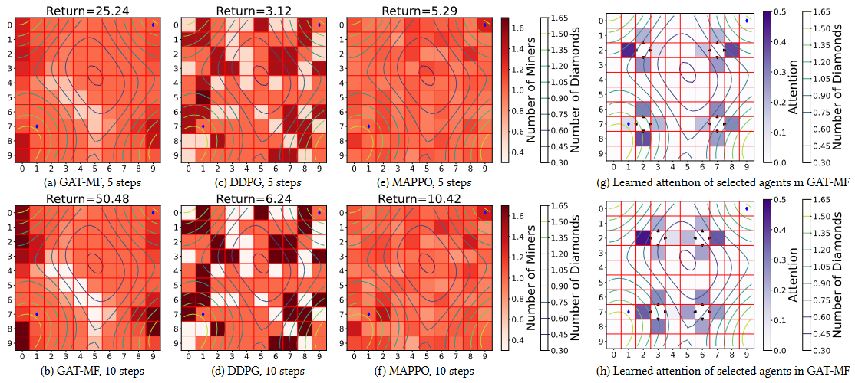
Experiment
In Figure a and b, authors show the distribution of miners after applying the policy from a trained GAT-MF model for 5 and 10 steps. From these we find the agents have learned reasonable policy, quickly making the miners gather at grids with the most diamonds, e.g., the left-upper and leftlower corner in the shown example. On the other hand, authors show in Figure c-f the distribution of miners after applying policies from a trained DDPG model and a trained MAPPO model for 5 and 10 steps, which are respective representatives of global agent and CTDE methods. The DDPG policy tends to be like random movements and the MAPPO policy tends to only do very slight movements.
Notes:
在图 a 和 b 中，展示了应用训练有素的 GAT-MF 模型的策略 5 步和 10 步后矿工的分布情况。从中我们可以发现，代理学习到了合理的策略，能迅速让矿工聚集到钻石最多的网格，例如图中的左上角和左下角。另一方面，在图 5c-5f 中展示了应用训练有素的 DDPG 模型和训练有素的 MAPPO 模型 5 步和 10 步策略后矿工的分布情况，它们分别是全局代理和 CTDE 方法的代表。DDPG 策略倾向于随机移动，而 MAPPO 策略倾向于只做非常轻微的移动。

Slide 16
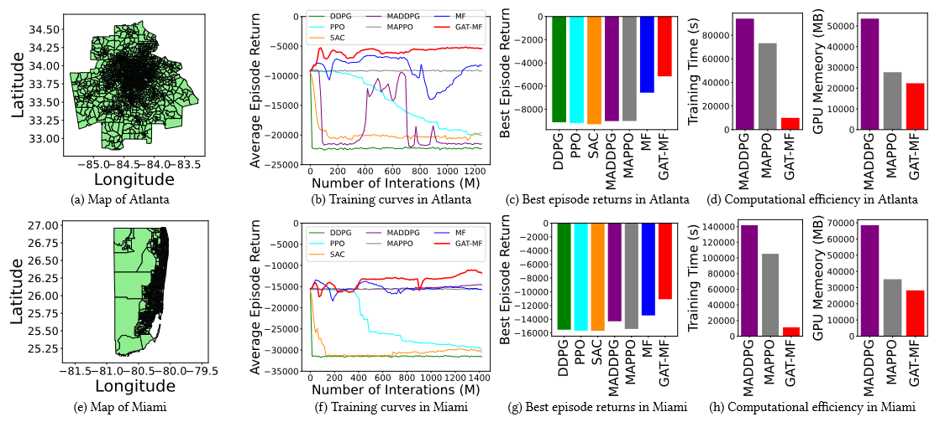
Experiment
The results illustrate that in this larger scenario with thousands of agents, all the baseline methods failed to learn useful strategies and some of them are even worse than a randomly initialized model. In contrast, our method reaches a good performance rapidly and converges stably, showing superior performance comparing the best baseline with the margin of 42.7% and 22.9% in Atlanta and Miami, respectively. The unweighted MF method ranks second in both cities, verifying the validity of the mean field approximation. On the other hand, its performance decay comparing the full GAT-MF verifies the key role of our GAT design.
Notes:
结果表明，在这个有数千个代理的大型场景中，所有基线方法都无法学习到有用的策略，其中一些方法甚至比随机初始化模型还差。
相比之下，我们的方法能迅速达到良好的性能并稳定收敛。非加权 MF 方法在这两个城市都排名第二，验证了平均场近似的有效性。
另一方面，与完整的 GAT-MF 相比，其性能衰减验证了我们的 GAT 设计的关键作用。

Slide 17
`
Conclusion
04
Notes:
最后是总结

Slide 18
Conclusion
In this paper, authors propose the GAT-MF method, which addresses the challenge of scaling up the number of agents in MARL algorithms. By incorporating the graph attention mechanism, authors implemented the theoretical theorem into a practical MARL algorithm. authors conducted extensive experiments with the algorithm in both manual and real-world scenarios with more than 3000 agents. The results demonstrate the superior performance and high computational efficiency of the method, showcasing its potential for solving various real-world large-scale problems.
Notes:
在本文中，论文提出了 GAT-MF 方法，该方法解决了 MARL 算法中扩展代理数量的难题。
通过结合图关注机制，我们将理论定理应用到了实用的 MARL 算法中。作者用该算法在人工和实际场景中进行了大量实验，实验对象超过 3000 个。实验结果表明，我们的方法性能优越、计算效率高，在解决现实世界中的各种大规模问题方面具有巨大潜力。

Slide 19
Thanks
POWERPOINT TEMPLATE
李国文
2024 年 4 月 10 日

